Slide 1
Report on Titanic Disaster Survival Using Logistic Regression
Prepared by Shakil Ahammed

Slide 2

Introduction
In this project, we will be working with the titanic dataset. Our goal is to train a logistic regression model that will be able to predict the chances of survival in disaster.

Slide 3
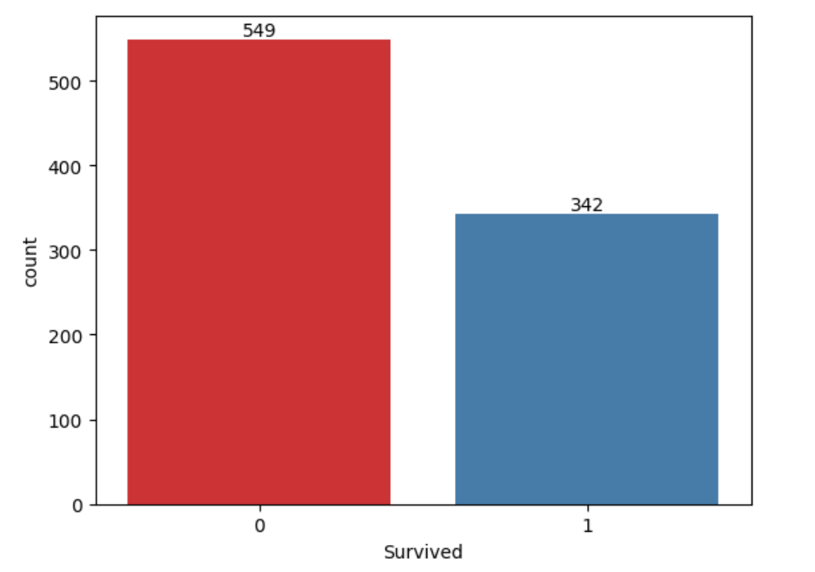
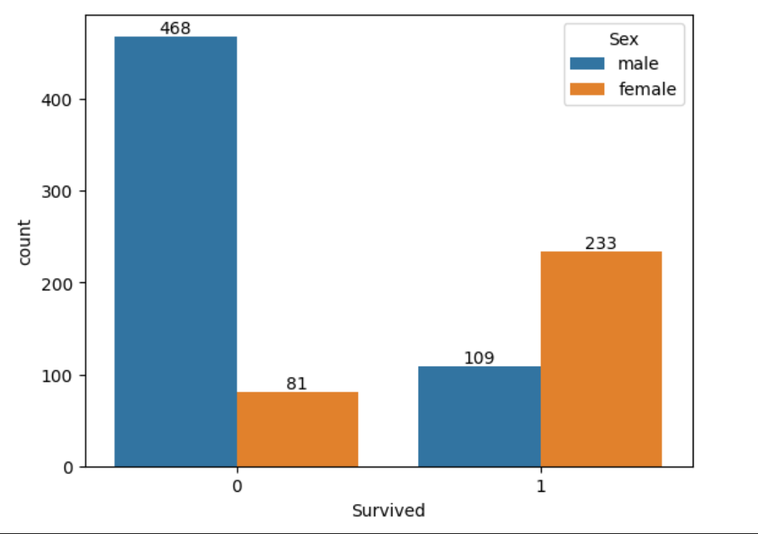
Insights
Total survived 549 person and dead 342. Among them male survived 109 and dead 468, female survived 233 and dead 81. Most number of survival is female.

Slide 4
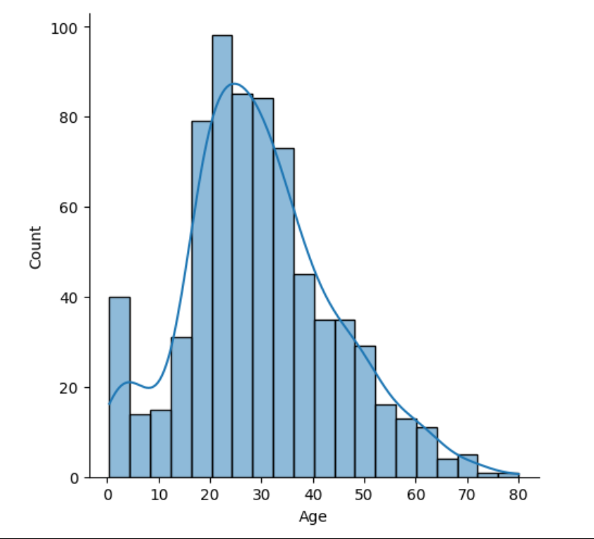
Age distribution of passenger of titanic.

Slide 5
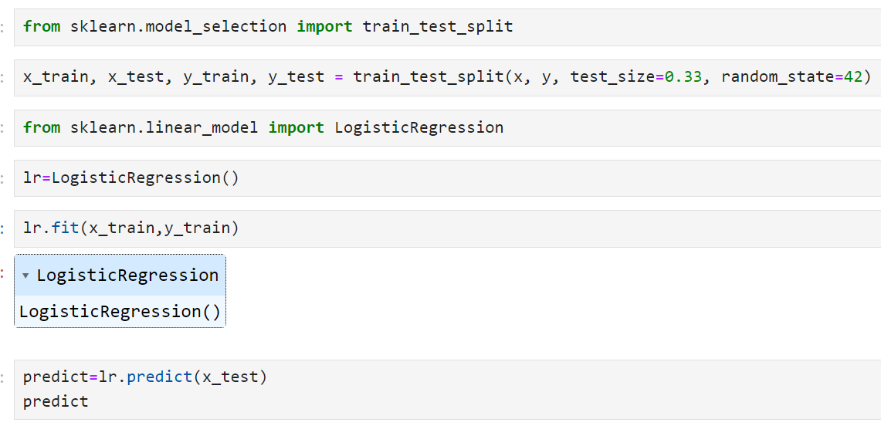
Building a Model
At first we divided the dataset into test part and train part using train test split method in scikitlearn library, then we train a logistic regression model.

Slide 6
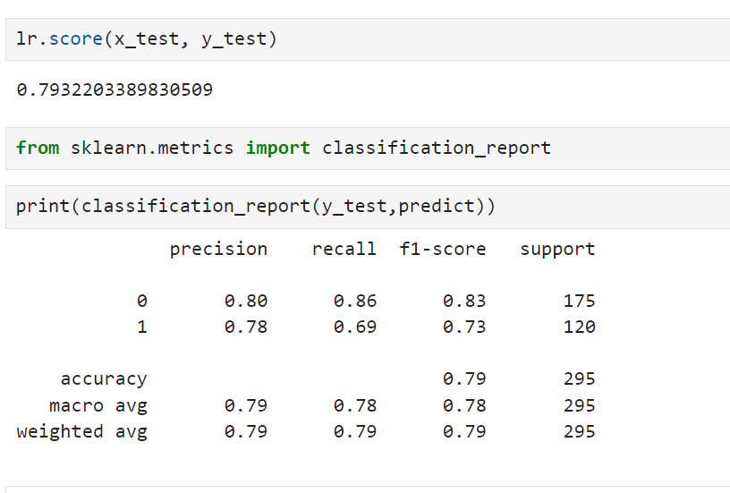
Precision : Precision is the ratio of correctly predicted positive observations to the total predicted positive observations. It is also called accuracy score. It’s a good score(79%). Recall : Recall is the ratio of correctly predicted positive observations to the all observations in actual class F1 score - F1 Score is the weighted average of Precision and Recall.

